Slide 1
GI Case Studies and Questions
Peds
Notes:
#26 pyloric stenosis
#24 intussusception

Slide 2
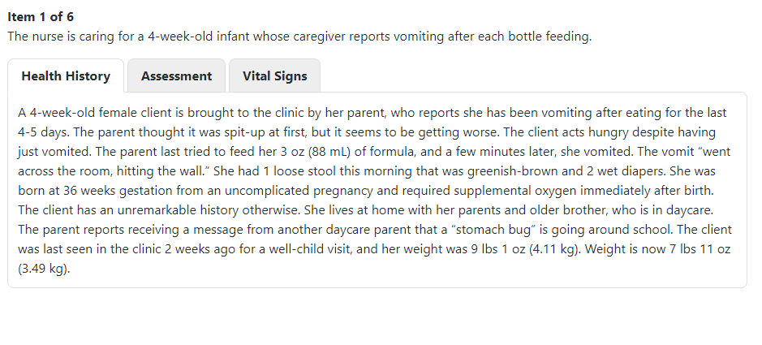

Slide 3
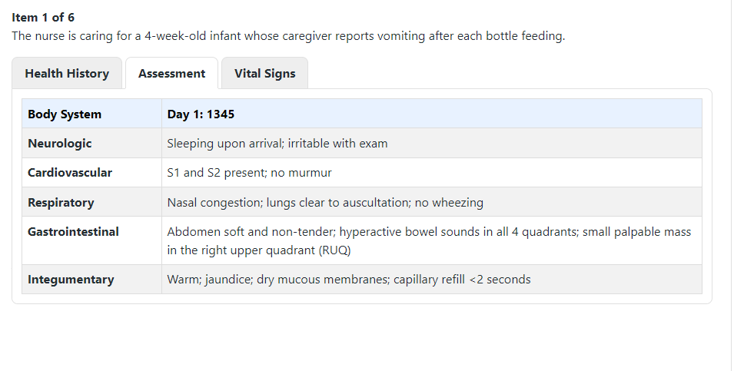

Slide 4
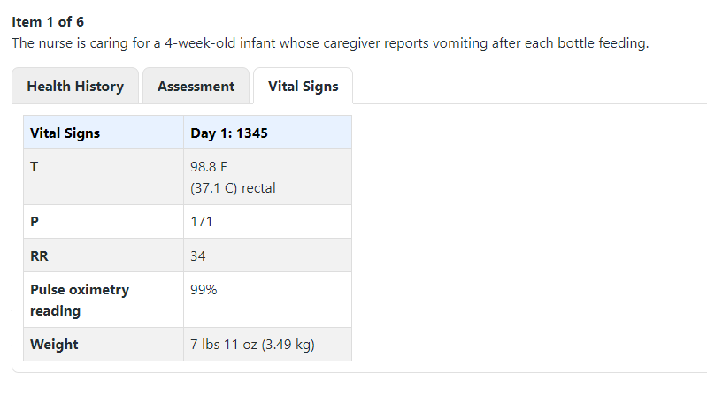

Slide 5

Which of the following findings require immediate follow-up?
Loose stool
Irritability
Weight
Vomiting
Gestational age
Nasal congestion
Sick contacts at daycare
Hyperactive bowel sounds
Tachycardia
Jaundice

Slide 6
Which of the following 4 findings require immediate follow-up?
Loose stool
Irritability
Weight
Vomiting
Gestational age
Nasal congestion
Sick contacts at daycare
Hyperactive bowel sounds
Tachycardia
Jaundice

Slide 7
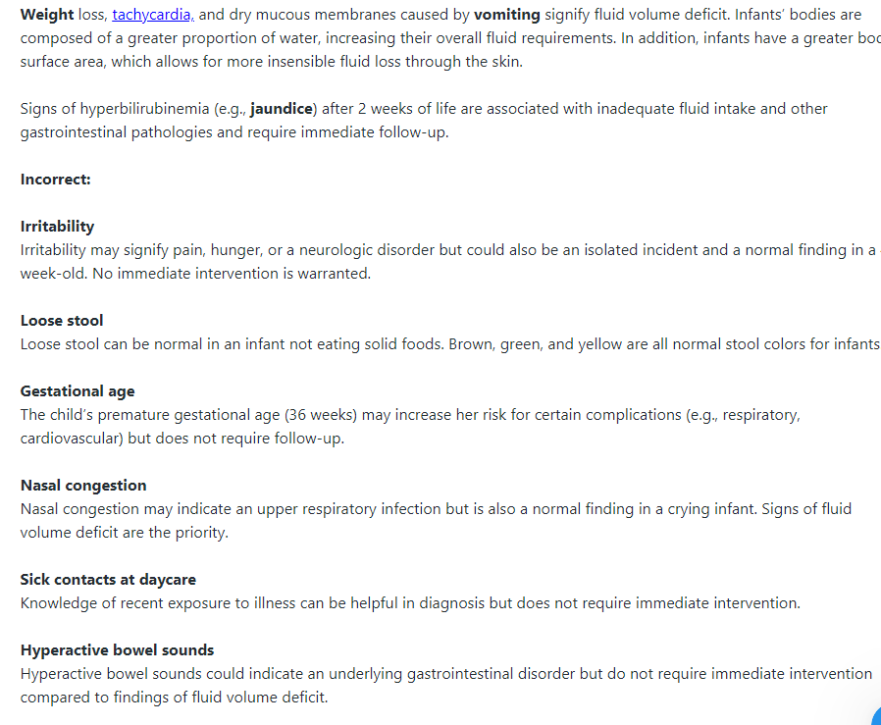

Slide 8
For each client finding, click to specify if the finding is consistent with the disease process of gastroenteritis, intussusception, or pyloric stenosis. Each finding may support more than one disease process.
Client Finding | Gastroenteritis | Intussusception | Pyloric Stenosis
Vomiting
Weight Loss
Loose stool
Abdominal mass
Maintains appetite
Exposure to sick contacts

Slide 9
For each client finding, click to specify if the finding is consistent with the disease process of gastroenteritis, intussusception, or pyloric stenosis. Each finding may support more than one disease process.
Client Finding | Gastroenteritis | Intussusception | Pyloric Stenosis
Vomiting | x | x | x
Weight Loss | x | x | x
Loose stool | x | x
Abdominal mass |  | x | x
Maintains appetite |  |  | x
Exposure to sick contacts | x

Slide 10
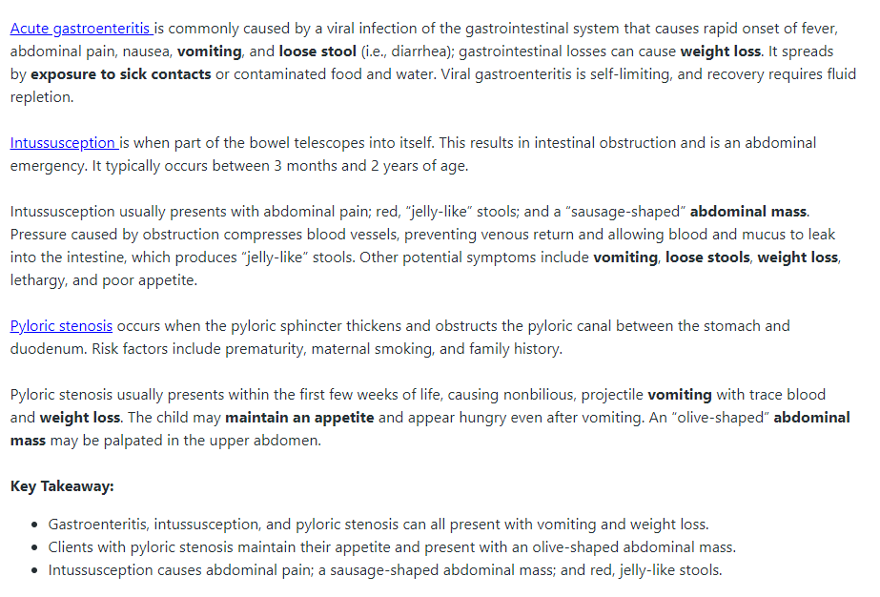

Slide 11
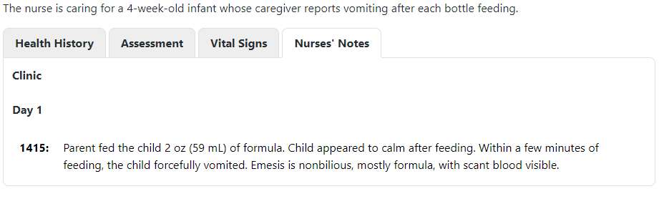

Slide 12
The nurse has reviewed the clinic Nurses’ Notes at 1415. Complete the following sentence by choosing from the list of options.
The nurse should recognize that the client is most likely experiencing
  Dehydration
  Pain
  Hypoglycemia
Due to
  Viral infection
  Pyloric stenosis
  Intussusception

Slide 13
The nurse has reviewed the clinic Nurses’ Notes at 1415. Complete the following sentence by choosing from the list of options.
The nurse should recognize that the client is most likely experiencing
  Dehydration
  Pain
  Hypoglycemia
Due to
  Viral infection
  Pyloric stenosis
  Intussusception

Slide 14
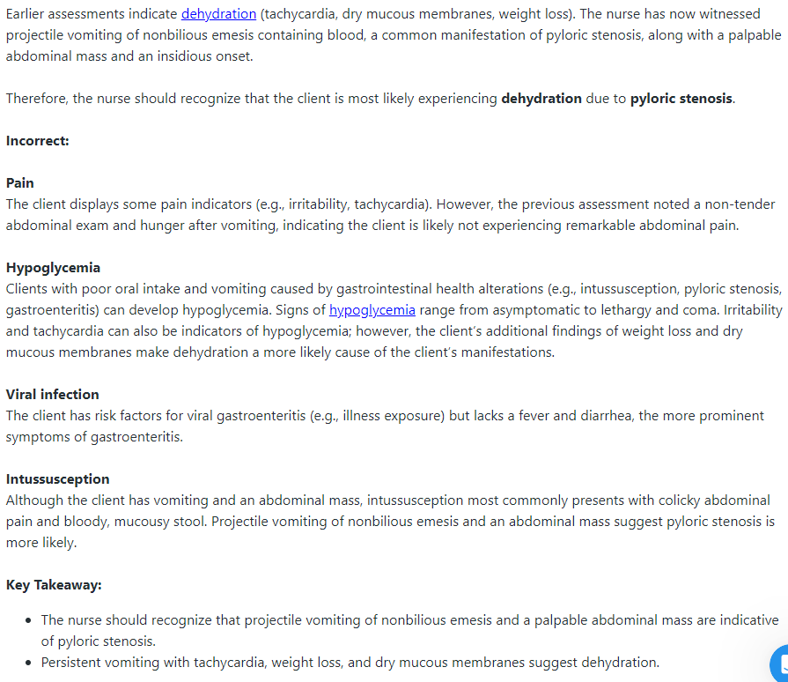

Slide 15
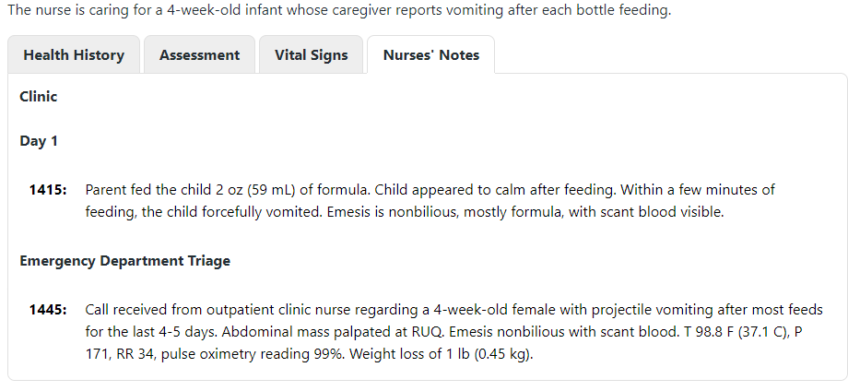

Slide 16
The client has been transferred to the hospital and the emergency department nurse is now caring for the client. The nurse has reviewed the triage nurses’ notes from 1445. For each HCP order, click to specify if the order is anticipated or not anticipated at this time.
Potential HCP Order | Anticipated | Not anticipated
Draw metabolic panel
Administer an ondansetron
Provide a clear liquid diet
Initiate contact precautions
Perform an abdominal ultrasound
Maintain strict intake and output (I&Os)
Establish vascular access device (VAD) site

Slide 17
The client has been transferred to the hospital and the emergency department nurse is now caring for the client. The nurse has reviewed the triage nurses’ notes from 1445. For each HCP order, click to specify if the order is anticipated or not anticipated at this time.
Potential HCP Order | Anticipated | Not anticipated
Draw metabolic panel | x
Administer ondansetron |  | x
Provide a clear liquid diet |  | x
Initiate contact precautions |  | x
Perform an abdominal ultrasound | x
Maintain strict intake and output (I&Os) | x
Establish vascular access device (VAD) site | x

Slide 18
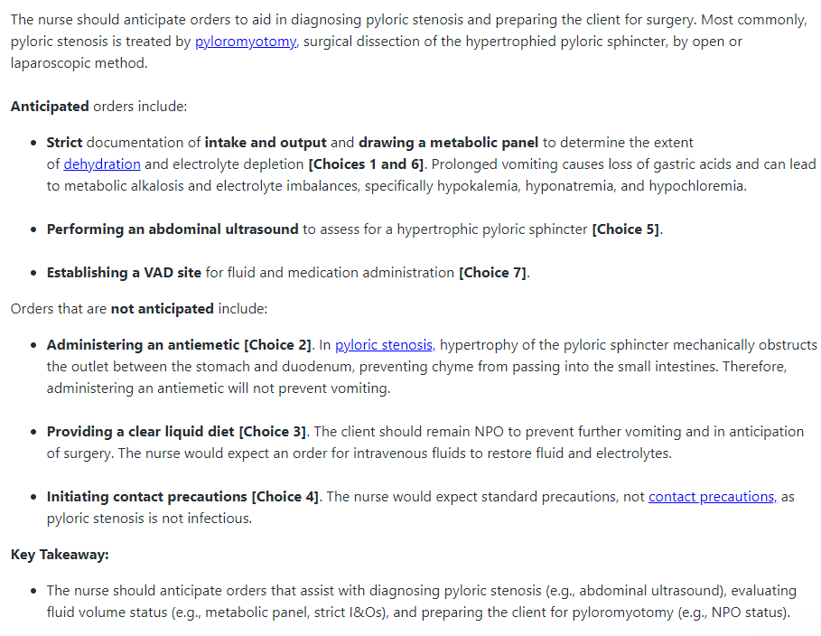

Slide 19
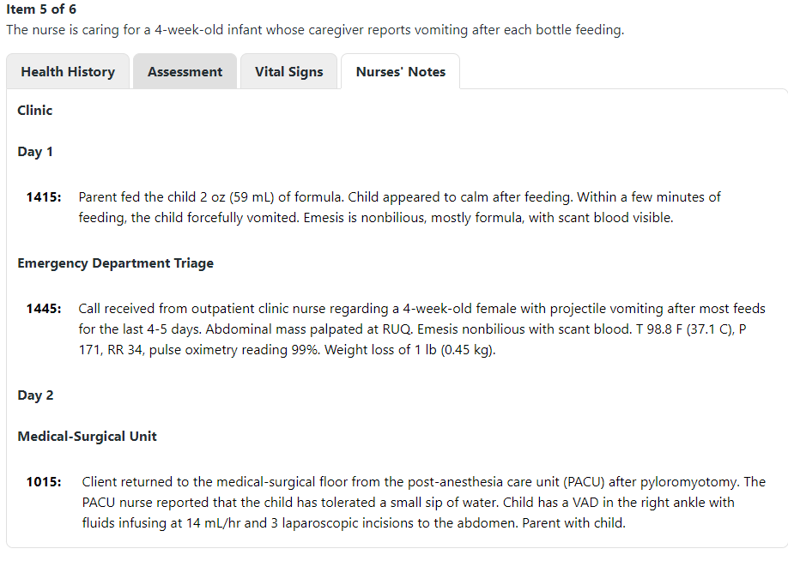

Slide 20
The nurse has reviewed the Nurses’ Notes from Day 2 at 1015
Select the three actions the nurse should take:
  Administer famotidine
  Measure abdominal girth
  Monitor intake and output
  Provide postoperative education to the client’s caregiver
  Encourage the caregiver to resume the preoperative feeding schedule

Slide 21
The nurse has reviewed the Nurses’ Notes from Day 2 at 1015
Select the three actions the nurse should take:
  Administer famotidine
  Measure abdominal girth
  Monitor intake and output
  Provide postoperative education to the client’s caregiver
  Encourage the caregiver to resume the preoperative feeding schedule

Slide 22
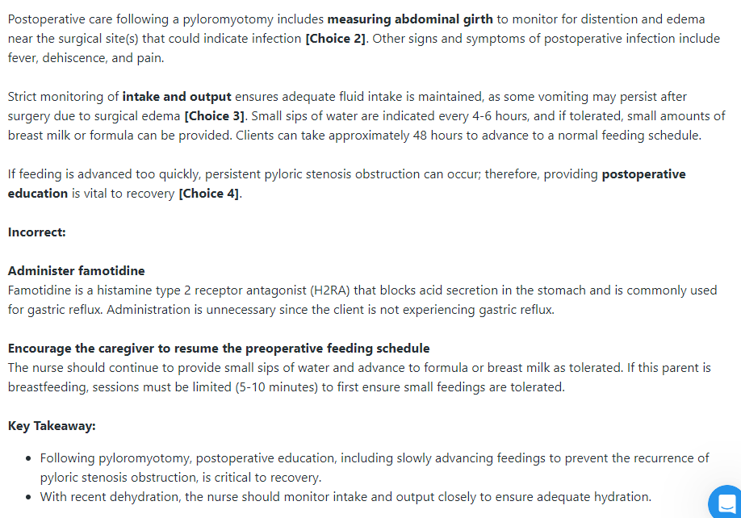

Slide 23
The nurse has begun discharge education with the caregiver. For each statement made by the caregiver, click to specify whether the statement indicates an understanding or no understanding of the teaching provided.
Client Statement | Understanding | No Understanding
“I caused this condition by overfeeding my child.”
“I should feed my child slowly and burp her frequently.”
“I should continue to give my child water to keep her hydrated.”
“I should make sure she is having more than six wet diapers a day.”
“I should tell my provider if there is redness or discharge at the incision.”
“My child will require long-term diet changes to prevent further complications.”

Slide 24
The nurse has begun discharge education with the caregiver. For each statement made by the caregiver, click to specify whether the statement indicates an understanding or no understanding of the teaching provided.
Client Statement | Understanding | No Understanding
“I caused this condition by overfeeding my child.” |  | x
“I should feed my child slowly and burp her frequently.” | x
“I should continue to give my child water to keep her hydrated.” |  | x
“I should make sure she is having more than six wet diapers a day.” | x
“I should tell my provider if there is redness or discharge at the incision.” | x
“My child will require long-term diet changes to prevent further complications.” |  | x

Slide 25
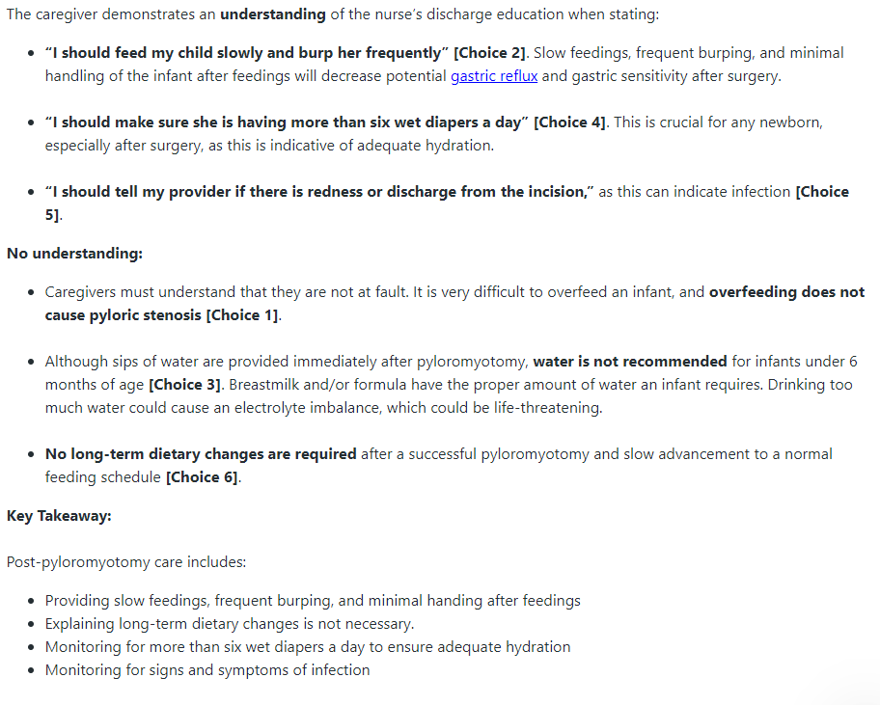

Slide 26

Next Case

Slide 27
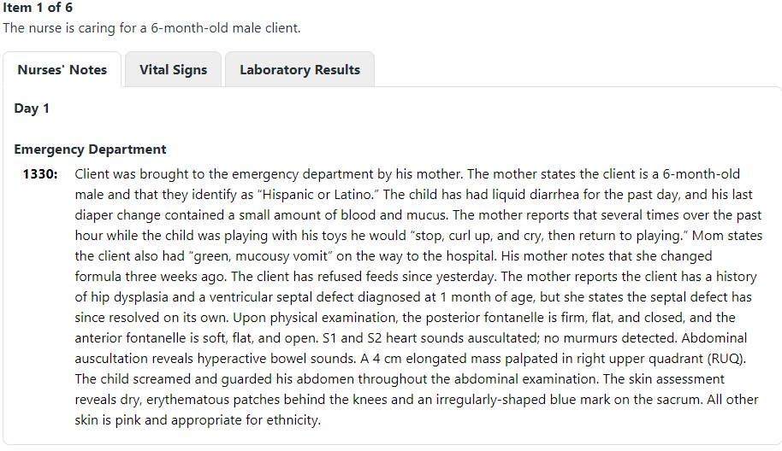
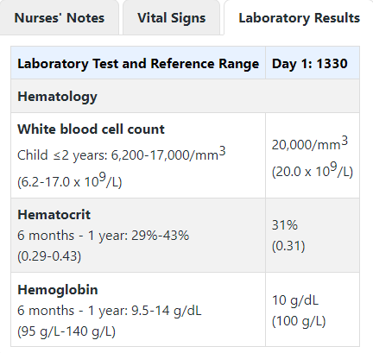
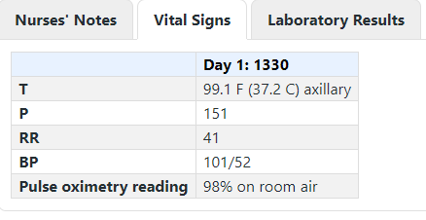

Slide 28
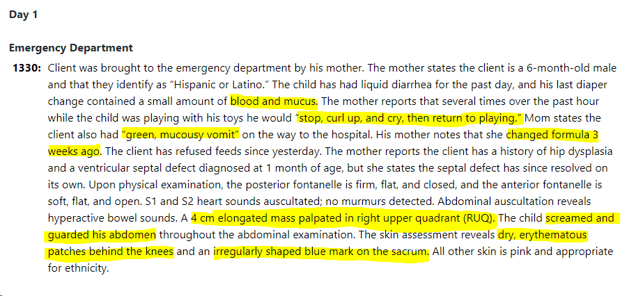
From the options highlighted, choose the findings requiring immediate follow-up

Slide 29
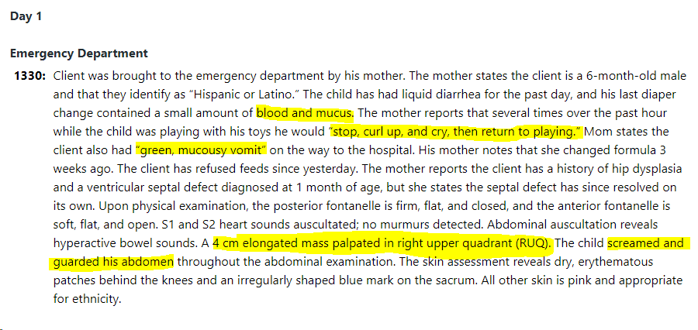

Slide 30
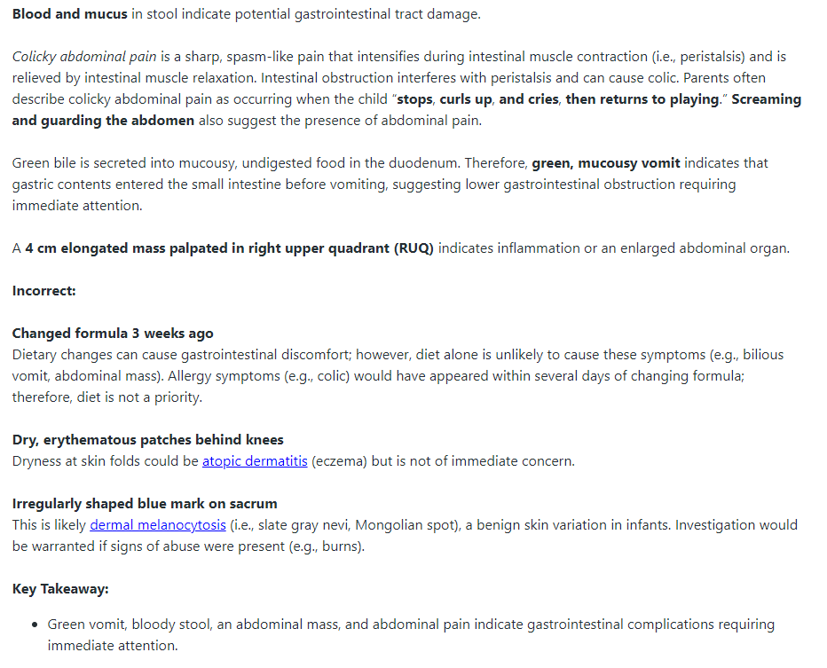

Slide 31
For each client finding below, click to specify if the finding is consistent with the disease process of appendicitis, intussusception, or hypertrophic pyloric stenosis. Each finding may support more than 1 disease process
Assessment Findings | Appendicitis | Intussusception | Hypertrophic Pyloric Stenosis
Diarrhea
Green vomit
Stool with blood and mucus
Increased white blood cell count
Right upper quadrant abdominal mass

Slide 32
For each client finding below, click to specify if the finding is consistent with the disease process of appendicitis, intussusception, or hypertrophic pyloric stenosis. Each finding may support more than 1 disease process
Assessment Findings | Appendicitis | Intussusception | Hypertrophic Pyloric Stenosis
Diarrhea | x | x
Green vomit |  | x
Stool with blood and mucus |  | x
Increased white blood cell count | x | x
Right upper quadrant abdominal mass |  | x | x

Slide 33
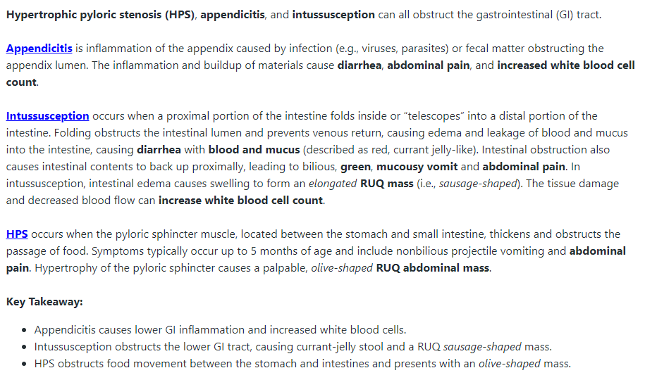

Slide 34
The nurse should be most concerned about
  Failure to thrive
  Bowel perforation
  Fluid and electrolyte imbalance
Due to
  Ischemia
  Poor intake
  Vomiting and diarrhea

Slide 35
The nurse should be most concerned about
  Failure to thrive
  Bowel perforation
  Fluid and electrolyte imbalance
Due to
  Ischemia
  Poor intake
  Vomiting and diarrhea

Slide 36
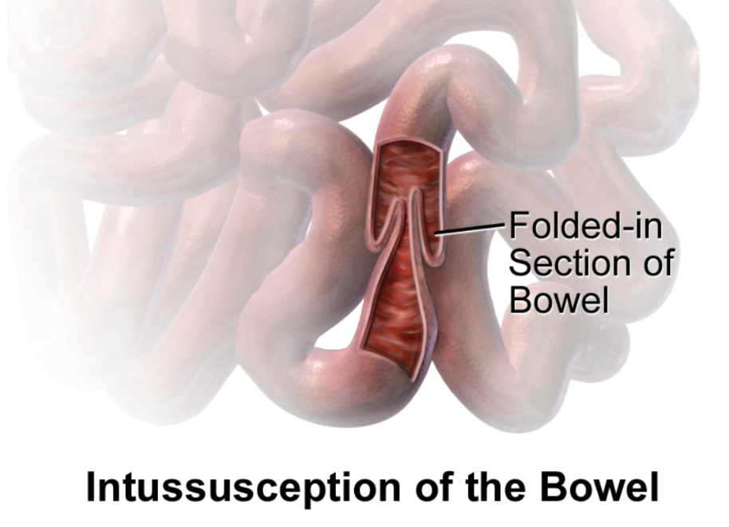
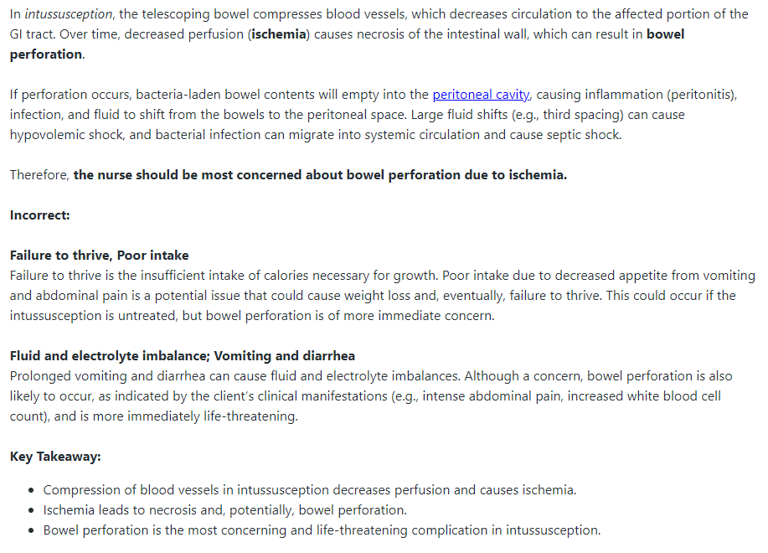

Slide 37
For each potential intervention, click to specify whether the potential intervention is indicated or contraindicated for the care of the client.
Potential Interventions | Indicated | Contraindicated
Maintain NPO Status
Administer loperamide
Prepare for a barium swallow
Prepare for abdominal ultrasound
Collect blood for a basic metabolic panel
Prepare for reduction of telescoped bowel

Slide 38
For each potential intervention, click to specify whether the potential intervention is indicated or contraindicated for the car of the client.
Potential Interventions | Indicated | Contraindicated
Maintain NPO Status | x
Administer loperamide |  | x
Prepare for a barium swallow |  | x
Prepare for abdominal ultrasound | x
Collect blood for a basic metabolic panel | x
Prepare for reduction of telescoped bowel | x

Slide 39
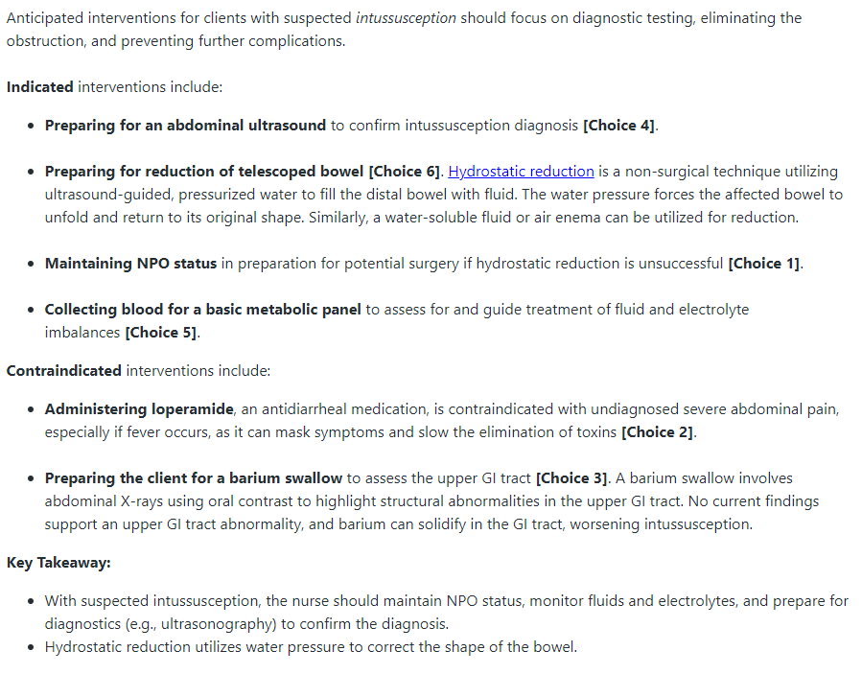

Slide 40
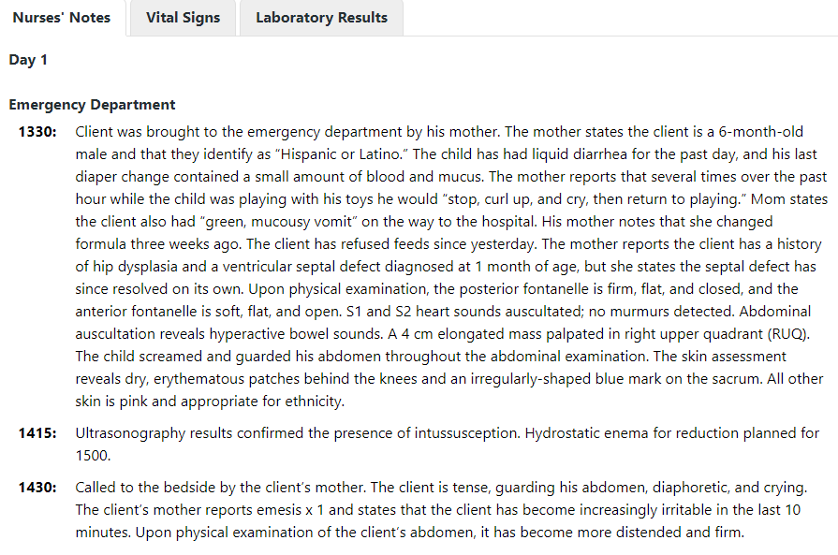
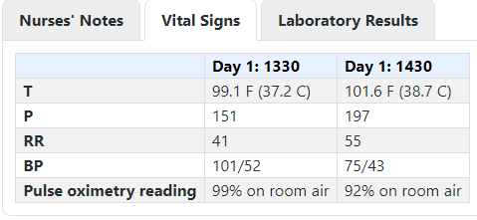

Slide 41
The nurse reviews the Nurse’s Notes from 1415 and 1430 and the Vital Signs from 1430.
What are the 4 most important interventions to perform at this time?
Insert nasogastric tube
Administer IV ampicillin
Administer IV ondansetron
Obtain an arterial blood gas
Provide supplemental oxygen
Administer IV normal saline bolus
Insert an indwelling urinary catheter
Obtain signed consent for surgery from the client’s mother

Slide 42
The nurse reviews the Nurse’s Notes from 1415 and 1430 and the Vital Signs from 1430.
What are the 4 most important interventions to perform at this time?
Insert nasogastric tube
Administer IV ampicillin
Administer IV ondansetron
Obtain an arterial blood gas
Provide supplemental oxygen
Administer IV normal saline bolus
Insert an indwelling urinary catheter
Obtain signed consent for surgery from the client’s mother

Slide 43
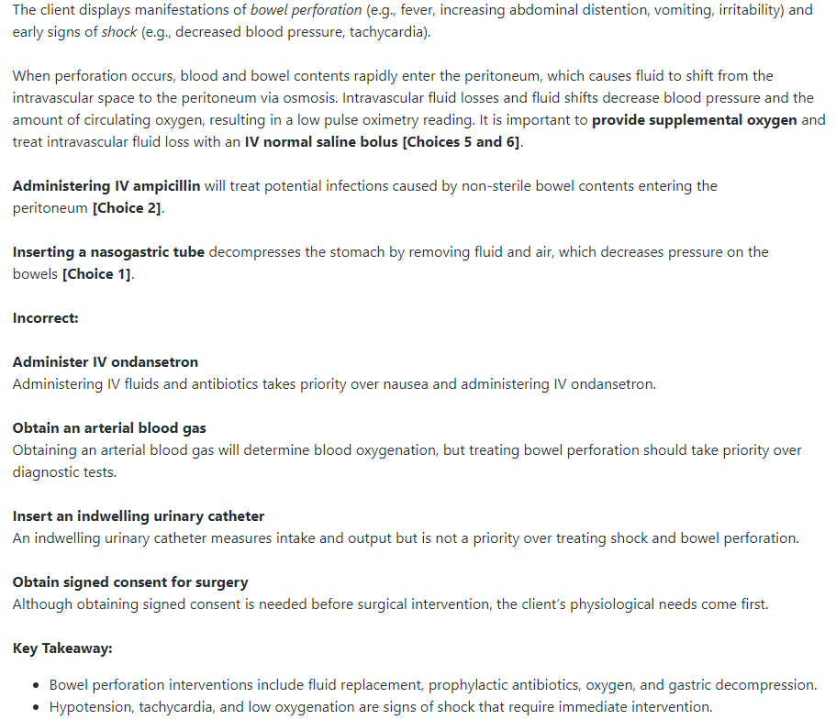

Slide 44
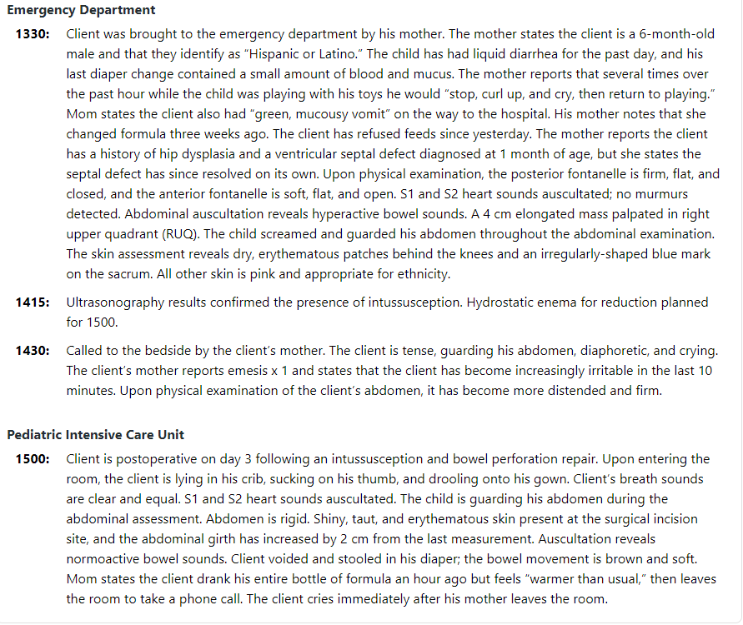

Slide 45
The client underwent surgery for intussusception and bowel perforation repair. The nurse reviews the Nurse’s Notes from Day 4 at 1500. Which findings require follow-up?
Bowel movement is brown and soft
Mother states the client feels “warmer than usual”
Client cries when mother leaves the room
Client is sucking his thumb and drooling onto his gown
Shiny and taut erythematous skin at the surgical incision
Abdominal girth has increased 2 cm since the last measurement

Slide 46
The client underwent surgery for intussusception and bowel perforation repair. The nurse reviews the Nurse’s Notes from Day 4 at 1500. Which findings require follow-up?
Bowel movement is brown and soft
Mother states the client feels “warmer than usual”
Client cries when mother leaves the room
Client is sucking his thumb and drooling onto his gown
Shiny and taut erythematous skin at the surgical incision
Abdominal girth has increased 2 cm since the last measurement

Slide 47
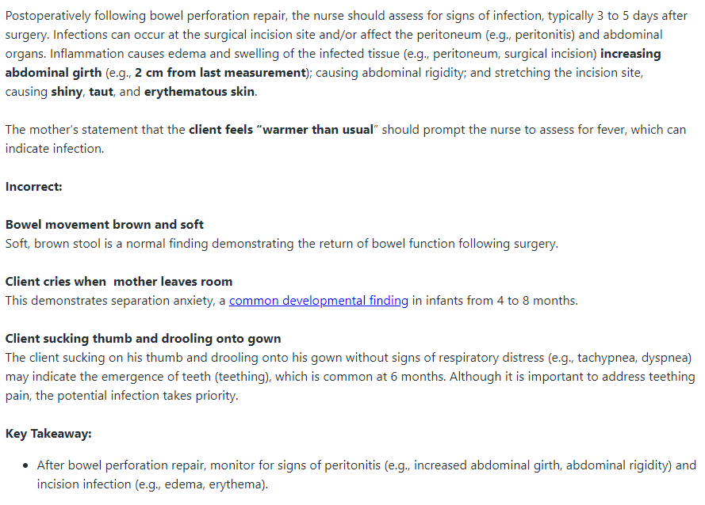

Slide 48
Reference
Bootcamp.com. (2024). Case studies. https://app.bootcamp.com/nclex/next-gen-cases

Slide 49
More Questions…

Slide 50
Calculate Urine Output
A nurse is caring for a 5-year-old client who has had 220 ml of urine out over the past 6-hour period. The child weighs 50 pounds. What is this client’s urine output (ml/kg/hr)?
Notes:
Answer: 50/2.2= 22.727 kg
220 ml/22.727 kg/6 hr= 1.61 ml/kg/hr
22.727kg x 6 hr = 136.38 ml/hr
220/136.38= 1.61 ml/kg/hr

Slide 51
The nurse is caring for a child admitted with pyloric stenosis. Which clinical manifestation would likely have been noted in the child with this diagnosis?
Explosive diarrhea
Projectile vomiting
Severe abdominal pain
Frequent urination
Notes:
B
During the first weeks of life, the infant with pyloric stenosis often eats well and gains weight and then starts vomiting occasionally after meals. Within a few days the vomiting increases in frequency and force, becoming projectile. The child may have constipation, and peristaltic waves may be seen in the abdomen, but the child does not appear in severe pain. Urine output is decreased and urination is infrequent.

Slide 52
The nurse is examining a 7-year-old with suspected appendicitis. Which physical findings would indicate the possibility of appendicitis?
Tenderness that comes and goes in the lower abdomen
Persistent, right lower quadrant pain with rebound tenderness
Intermittent, left lower quadrant pain with rebound tenderness
Diffuse, intermittent abdominal pain
Notes:
B
With appendicitis, symptoms typically do not come and go. They are usually persistent and intensify with time. With appendicitis, maximal tenderness occurs in the area of the McBurney point in the right lower quadrant, not the left. There is pain upon palpation with rebound tenderness. Pain is usually in the right lower quadrant, not the left, and is persistent. There is pain on palpation with rebound tenderness. Pain typically occurs in the right lower quadrant and is persistent and intensifies with time.

Slide 53
A nurse is caring for a toddler who is postoperative following a cleft palate repair. Which of the following actions should the nurse take?
Restrain the toddler’s arms at the elbows
Feed the toddler with a spoon
Monitor the toddler’s oral temperature
Weigh the toddler every week
Notes:
Answer: a

